Slide 1
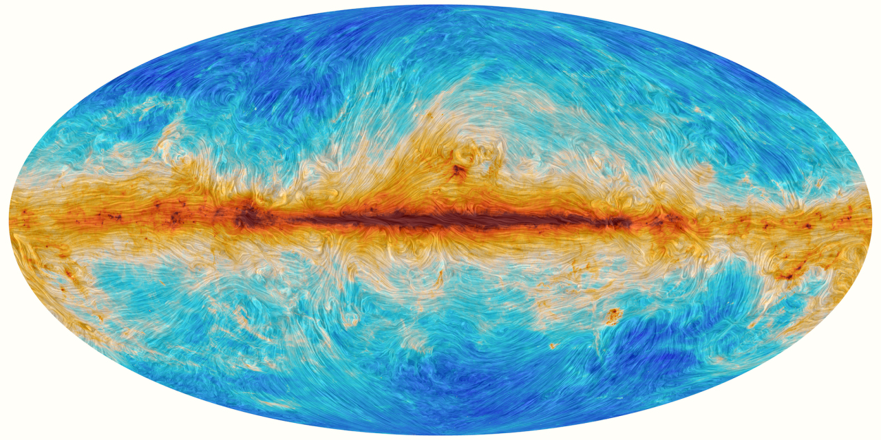
The Polarization Directional Spectrum - A New Turbulence Measure from Multi-frequency Synchrotron Polarization
Aliaksandr Melnichenka
Berea College
American Astronomical Society (AAS 248)
January 7, 2026
Phoenix, AZ.
Alex Lazarian (UW Madison)
Dmitry Pogosyan (University of Alberta)
Notes:
Names, conference name
“Imagine recovering the spectrum of interstellar magnetic turbulence from just one polarization map at one radio frequency. No RM synthesis. No wide bandwidth. That’s the core result of our work.”

Slide 2

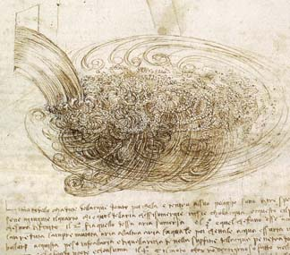
Turbulence is a chaotic order
c.1500
L. Da Vinci
It is important to know the laws of this order and use them
Notes:
Long before modern fluid dynamics, Leonardo da Vinci recognized that turbulence is not pure randomness — it’s an organized chaos. He saw repeating patterns in water eddies, a hierarchy of motion that hinted at an underlying order. This idea — order within chaos — became the foundation of modern turbulence theory, from Kolmogorov to MHD turbulence.

Slide 3

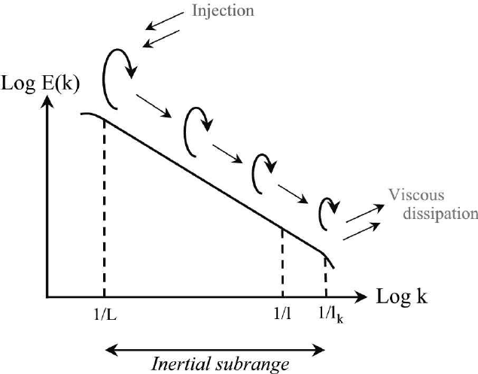
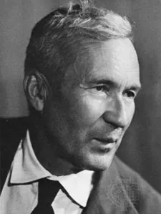
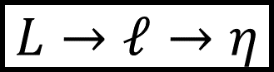
Turbulent energy cascade
$$L→ℓ→η$$
Constant turbulent energy transfer rate
https://commons.wikimedia.org/w/index.php?curid=64829708
Notes:
This process transfers kinetic energy from large scales (where it’s injected) to small scales (where it dissipates as heat).

Slide 4
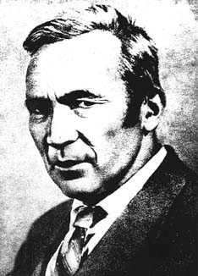
Kolmogorov theory reveals order in chaos for incompressible hydro turbulence
V²_{l} ²
= const
t _{cas,l}
V_{l}³
= const, V_{l} ~ l^{1/3}
t _{cas,l} = l/V_{l}
l
Or, E(k)~k^{-5/3/3}
l
Re>>1
Re~1
Viscosity is not
important
v_{l}
Viscosity is not
important
Viscous
dissipation
Re>>1
Notes:
4

Slide 5
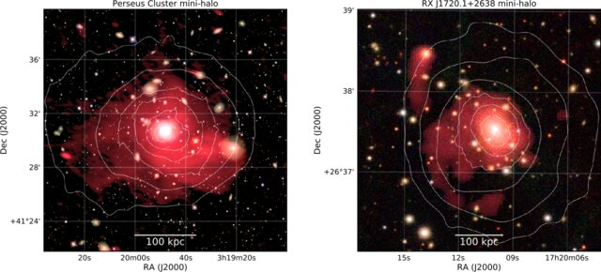
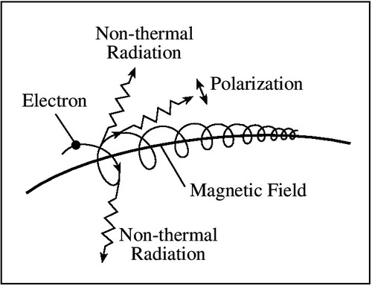
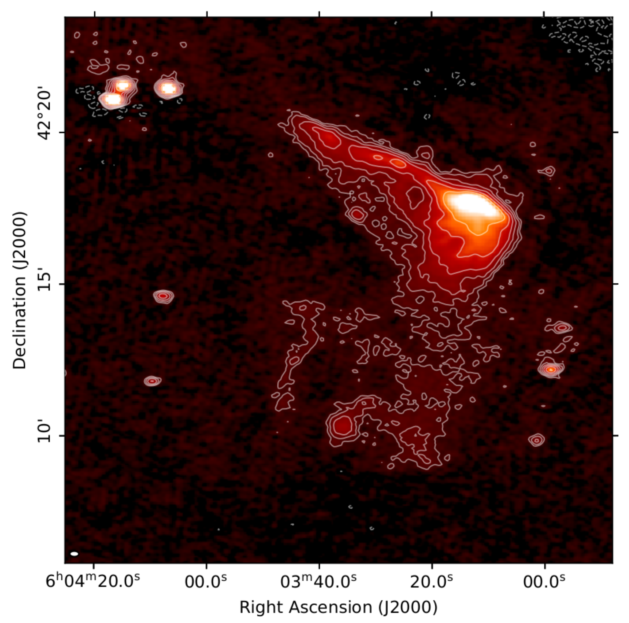
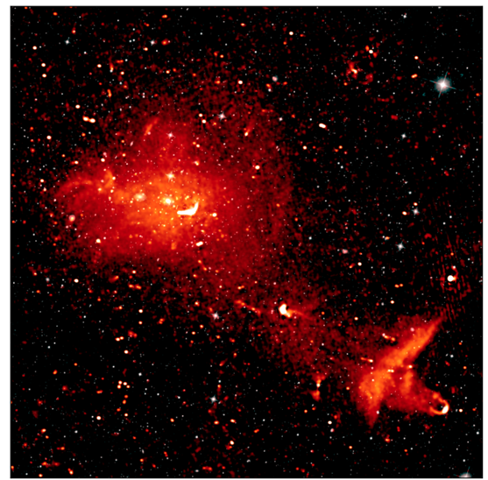
Typical magnetic field tracing method: synchrotron polarization
van Weeren et al. (2019)
Synchrotron emission
Wittor Denis (2023)
Bonafede et al. (2022)

Slide 6
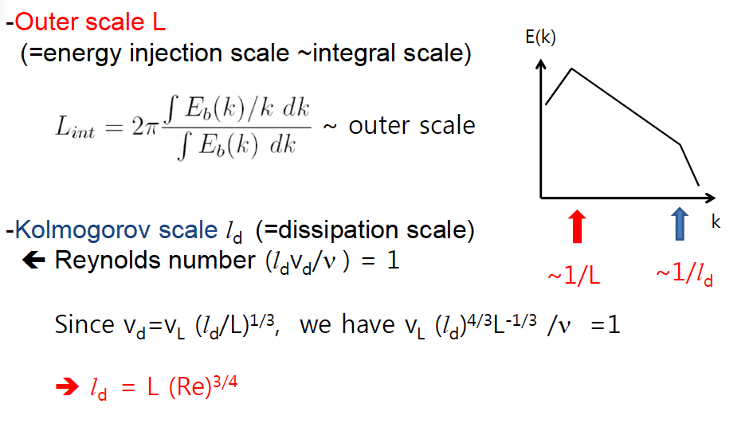
For turbulence the cascade is self-similar from the injection to the dissipation scales

Slide 7
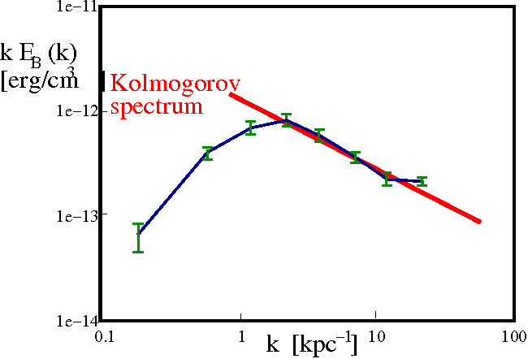
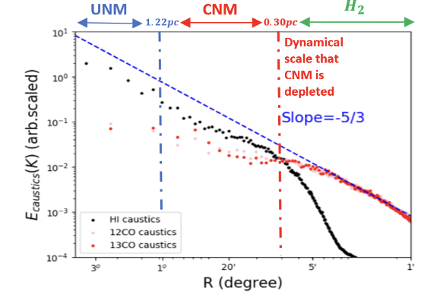
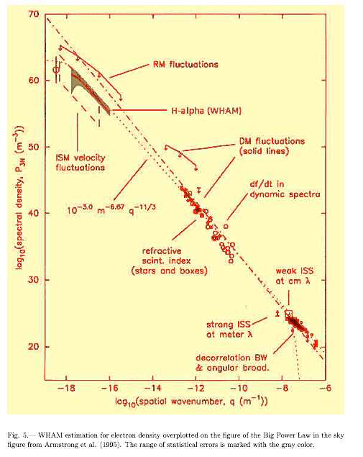
Kolmogorov spectrum is common in Astrophysics
Clusters of Galaxies
Magnetic fluctuations
Interstellar Medium
Velocity fluctuations
Interstellar Medium
Density fluctuations
Vogt & EnBlin 2005
Taurus region
420 pc
140pc
46.7pc
11.7pc
2.3pc
Distance (degrees,pc)
Kolmogorov spectrum
Yuen, Ho & AL 2021
Armstrong+ 95; Chepurnov & AL 09

Slide 8
Clusters of Galaxies
Interstellar Medium
Density fluctuations
Magnetic fluctuations
Kolmogorov spectrum
Vogt & EnBlin 2005
Armstrong+ 95; Chepurnov & AL 09

Slide 9
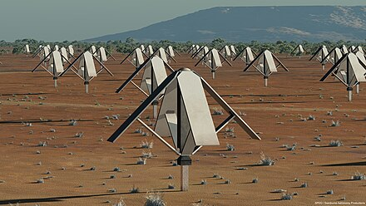
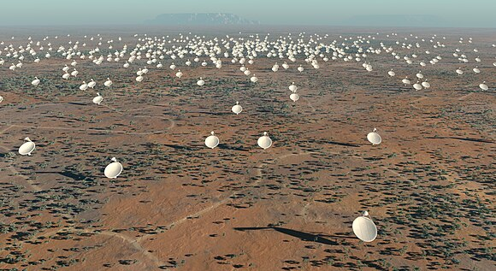
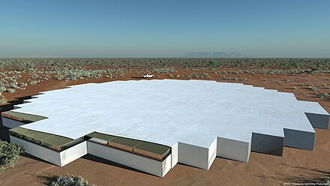
SKA to be commissioned in 2030: New data for SIGs
Notes:
For SIGs (Statistical Intensity Gradients) and turbulence diagnostics:
High dynamic range in polarization and Faraday depth;
Large survey volumes allow mapping of magnetized turbulence over many scales;

Slide 10
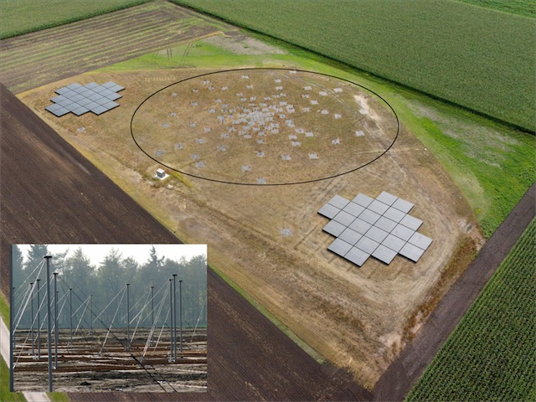
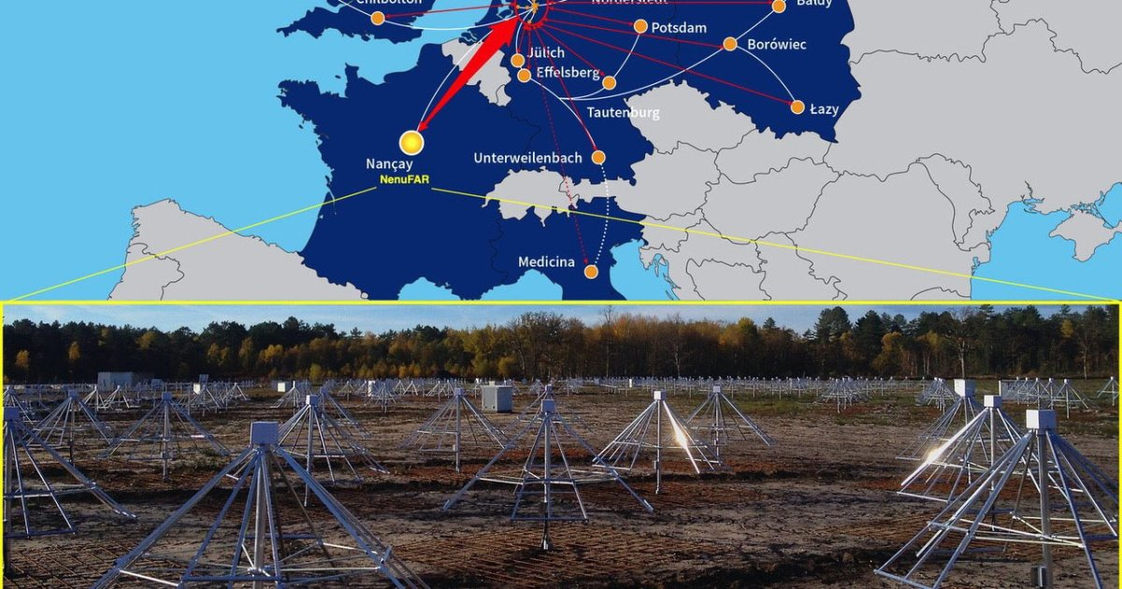
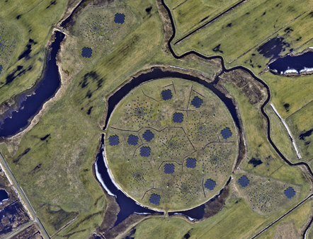
LOFAR is a gigantic European telescope measuring at 2 to 15 m radio wavelength

Slide 11
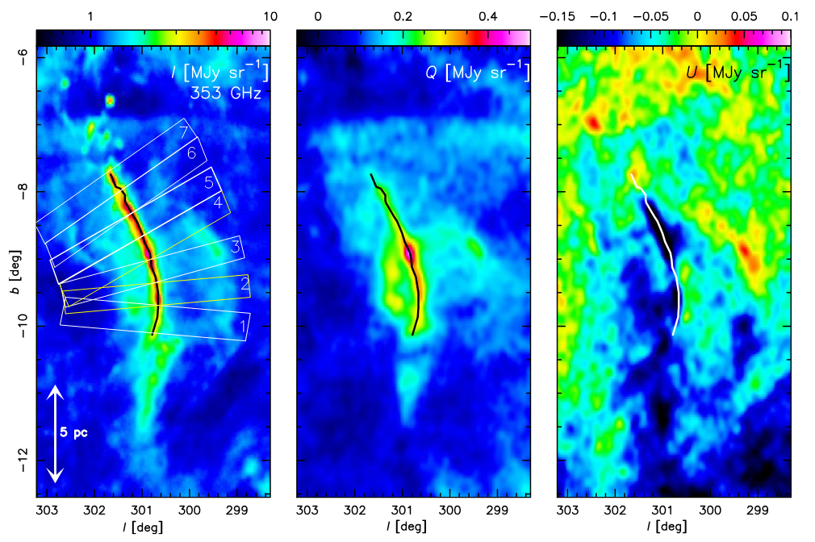
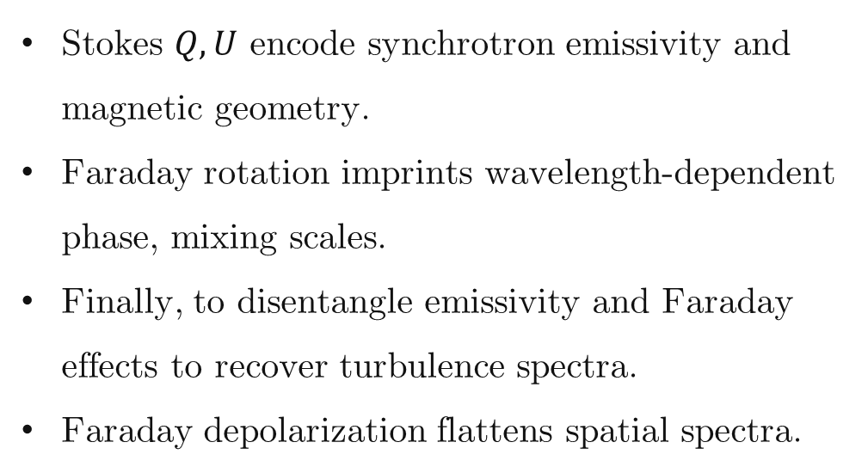
Why polarization maps? What current surveys give us
Stokes $Q, U$ encode synchrotron emissivity and magnetic geometry.
Faraday rotation imprints wavelength-dependent phase, mixing scales.
Finally, to disentangle emissivity and Faraday effects to recover turbulence spectra.
Faraday depolarization flattens spatial spectra.
Planck PR3 (2018) $353−GHz, I, Q, U$ full-sky maps (HEALPix)
We analyze spatial structure from wavelength to separate physical effects
Notes:
title
Planck, sections
Next slide: Faraday, path alternatives
Synchrton as good measure of magnetic field
informant
Magnetic turbulence is ubiquitous in astrophysics
(Armstrong et al. 1995). It shapes star formation (Fed-
errath 2016), angular momentum transport (Balbus &
Hawley 1991), and mediates conductivity and cosmic-
ray propagation (Brandenburg & Lazarian 2013), yet
most observational diagnostics are limited to 2D pro-
jections along the line of sight (LOS) (Elmegreen &
Scalo 2004). Faraday rotation is one of the most widely
used probes of these magnetized plasmas: from Galac-
tic RM grids and pulsars to cluster radio halos and FRBs, it reveals the LOS magnetic field weighted by
the thermal-electron density, and—through its spatial
statistics—encodes the underlying turbulence (e.g., see
the review by Akahori et al. 2018).

Slide 12
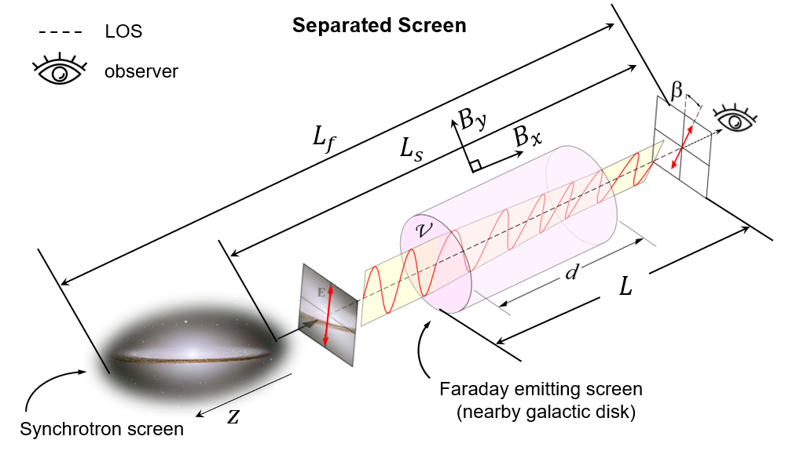
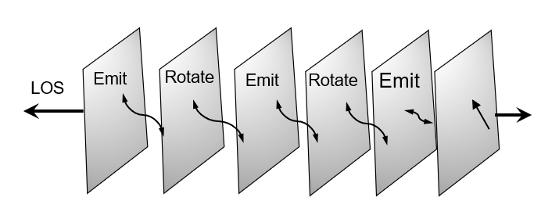
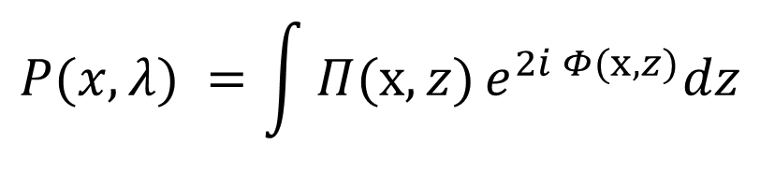
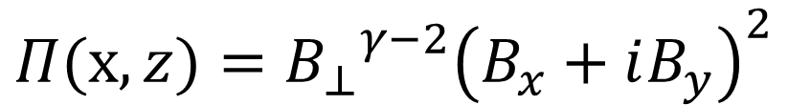


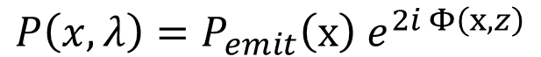
Propagation geometries: separated screen and mixed volume
With emissivity ($γ=2$):
$$Π(x,z)={{B_{⊥}}^{γ−2}\left(B_{x}+iB_{y}\right)}^{2}$$
Separated screen
(external RM screen in front of emitter)
Mixed volume
(emission and rotation in the same region)
$$P\left(x, λ\right)=P_{emit}\left(x\right) e^{2i Φ\left(x,z\right)}$$
$$P(x, λ) =\int{Π(x,z)}e^{2i Φ(x,z)}dz$$
$$P_{emit}\left(x\right)=\int{Π(x,z)}dz$$
Notes:
Lazarian_Pogosyan_2022 “At wavenumber k, the winner is set by a simple rule: when λ² times the RM dispersion at k is about one, the dominance flips. We call the corresponding wavenumber k-cross, and we can measure it from a single map. As λ increases, k-cross slides to smaller k, revealing a clean, predictable transition from synchrotron-dominated to Faraday-dominated structure.”

Slide 13

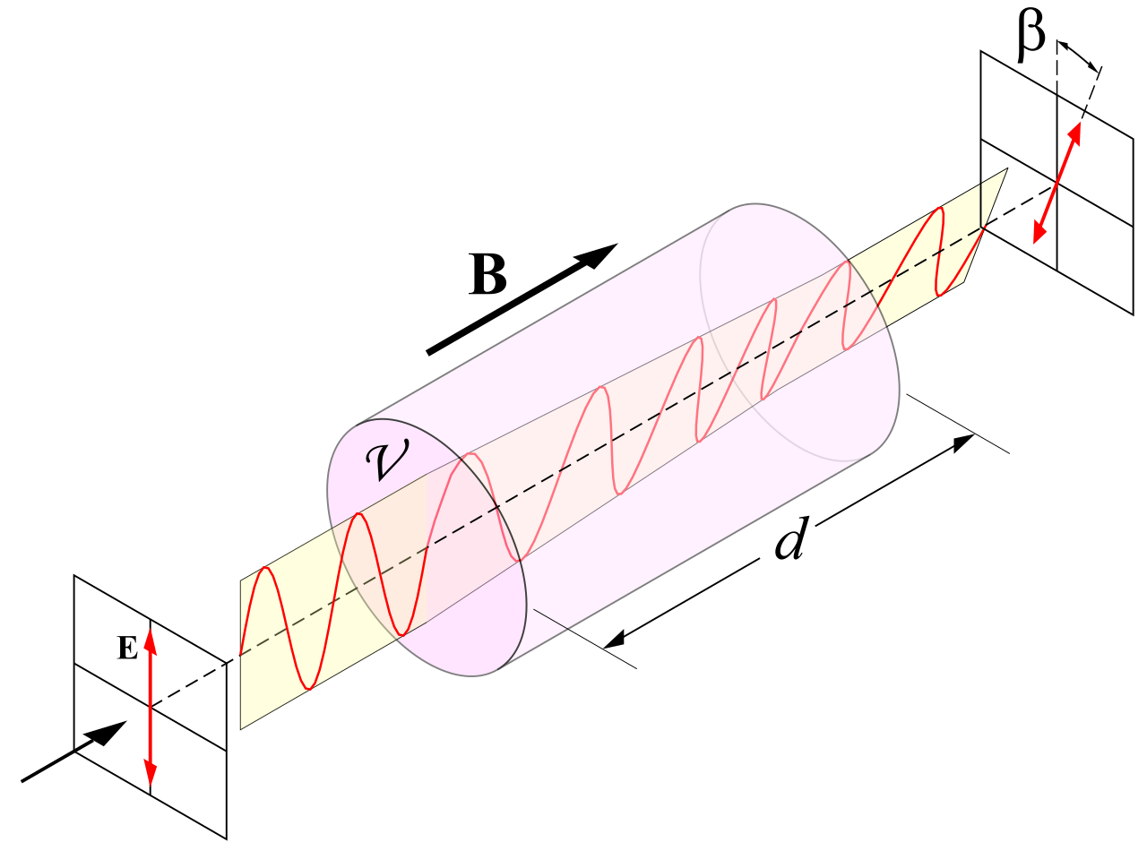
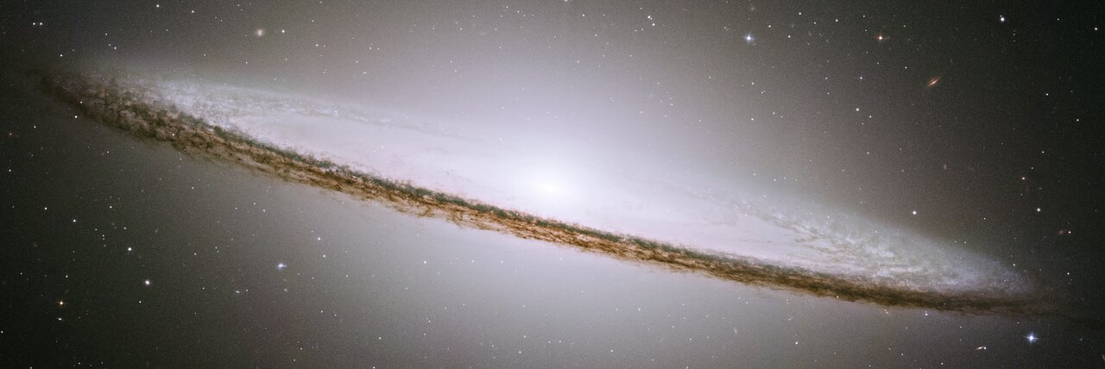
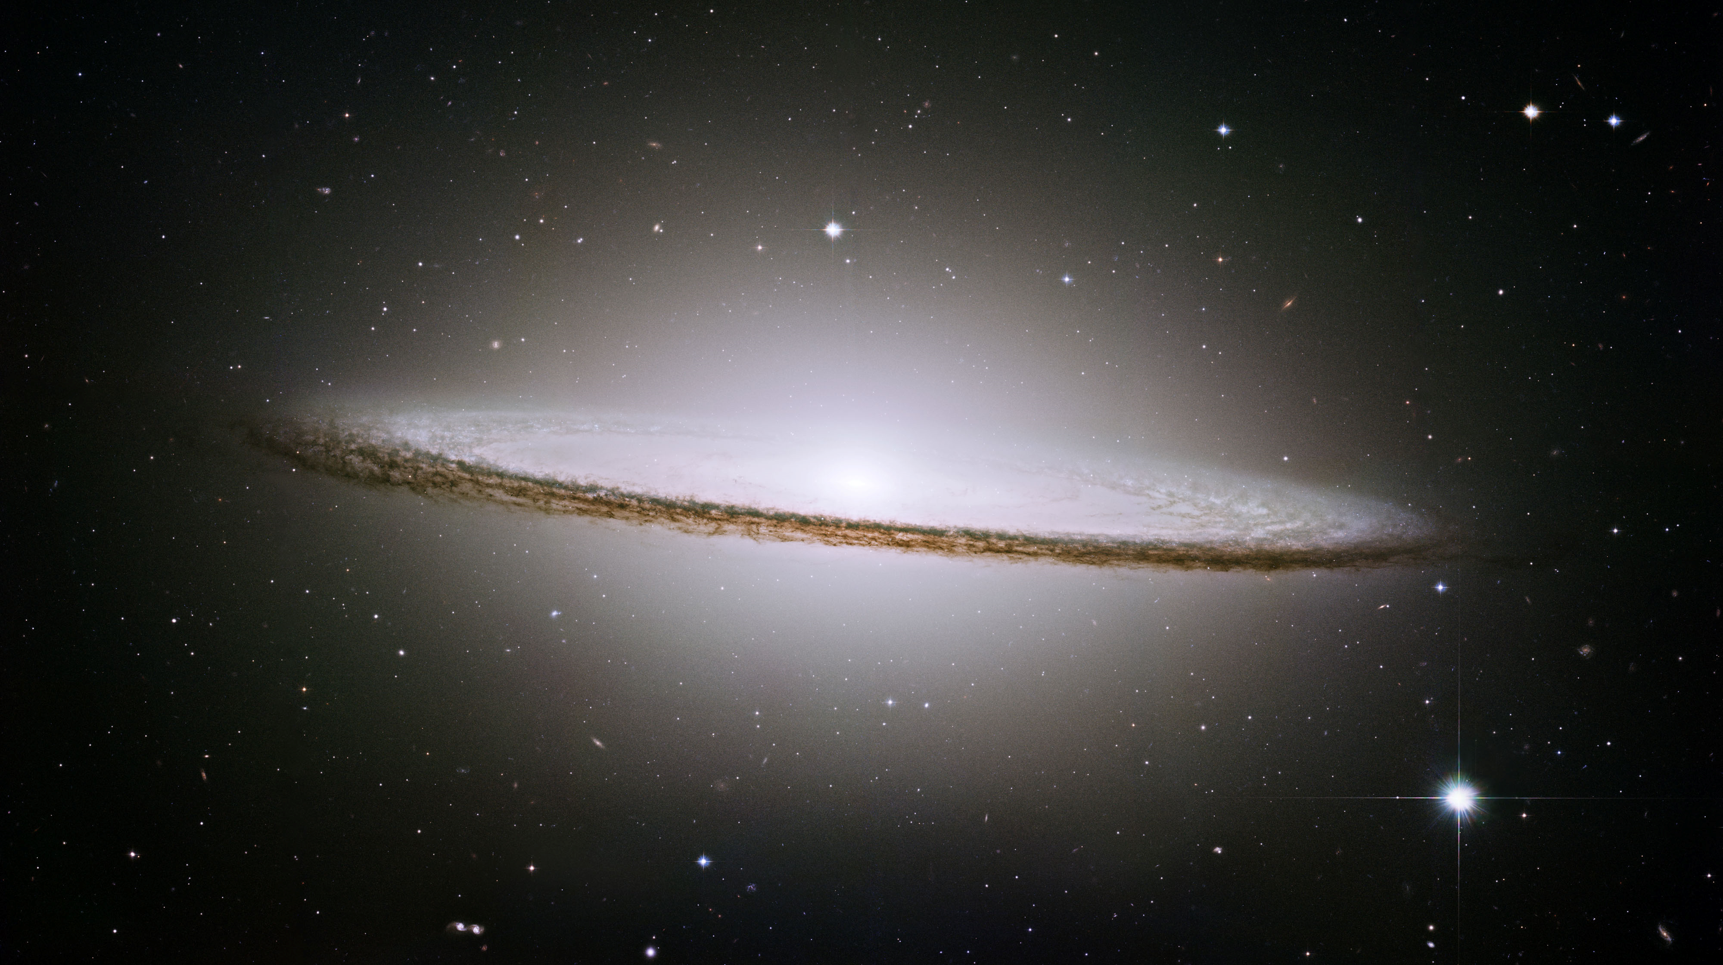
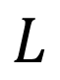
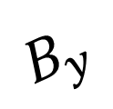
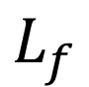
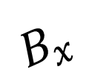
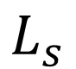
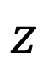
Separated Screen
LOS
observer
$$B_{y}$$
$$L_{f}$$
$$B_{x}$$
$$L_{s}$$
$$L$$
Faraday emitting screen
(nearby galactic disk)
$$z$$
Synchrotron screen
Notes:
The focus on this paper was on the most complex situation when the sources of the synchrotron radiation and thermal electrons
causing Faraday rotation occupy the same volume. Much simpler, but also astrophysically important, is the situation when
synchrotron originates in one distinct region while Faraday rotation acts on synchrotron radiation in another region. For instance, in
the studies of synchrotron emission from high galactic latitudes, one may consider that the synchrotron emission is generated in the
galactic halo, while the regions of the galactic disk close to the observer are responsible for the Faraday rotation. Below we cover this
special case of synchrotron turbulence study

Slide 14
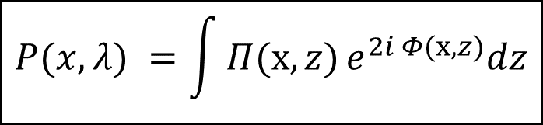
Mixed Volume
$$P(x, λ) =\int{Π(x,z)}e^{2i Φ(x,z)}dz$$
Rotate
Emit
Emit
Rotate
LOS
Emit

Slide 15
Polarization Angle Directional Correlation (PADC)
Compute from one map :
$$S(R) = ⟨\sin^{2}{[2(χ(x) − χ(x+R))]}⟩$$
New measure: directional spectrum (2-D Fourier power)
$$P_{dir}\left(k\right)={|FFT(cos(2χ)|}^{2}+{|FFT(sin(2χ)|}^{2}$$
Why it works:
no angle unwrapping
robust to filtering
directly maps to power spectrum
Notes:
NIO:: sin^2; constn!!“

Slide 16
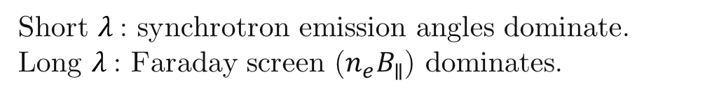
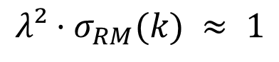
Emission vs. Faraday Screen: who dominates?
Polarization model (external screen):
$$P(x, λ) =e^{2i [ ψ_{emit}\left(x\right)+ λ^{2}RM\left(x\right)]}$$
Transition criterion (at scale k):
$$λ²·σ_{RM}(k) ≈ 1$$
defines crossover $k_{×} (λ)$
Short $λ$: synchrotron emission angles dominate.
Long $λ$: Faraday screen ($n_{e}B_{∥}$) dominates.
Standard Deviation of Rotation Measure
Notes:
1. Initiallly Draw the picture halo, thickness, and so on on the front title 2. here, plot when the dispertion increases (plot the layer, and some вихри) 3. more transition to simulations addres.
“At wavenumber k, the winner is set by a simple rule: when λ² times the RM dispersion at k is about one, the dominance flips. We call the corresponding wavenumber k-cross, and we can measure it from a single map. As λ increases, k-cross slides to smaller k, revealing a clean, predictable transition from synchrotron-dominated to Faraday-dominated structure.”

Slide 17
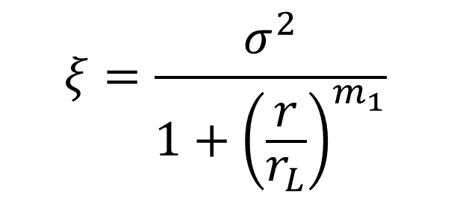
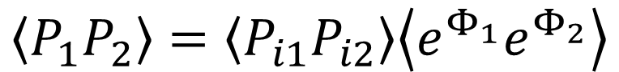

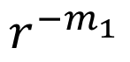
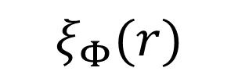
$$\left\langle P_{1}P_{2}\right\rangle =\left\langle P_{i1}P_{i2}\right\rangle \left\langle e^{Φ_{1}}e^{Φ_{2}}\right\rangle$$
$$ξ_{1}(r)$$
$$ξ_{Φ}(r)$$
$$ξ$$
$$r_{1}$$
$$r^{−m_{1}}$$
$$r_{φ}$$
$$ξ=\frac{σ^{2}}{1+{\left(\frac{r}{r_{L}}\right)}^{m_{1}}}$$
$$r_{1}$$

Slide 18
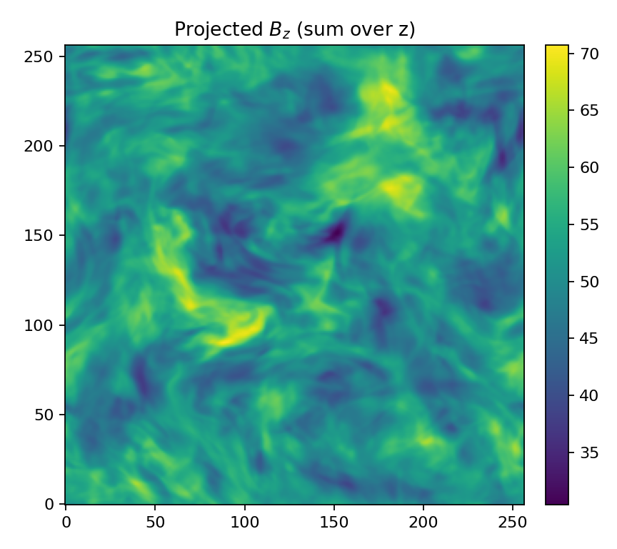
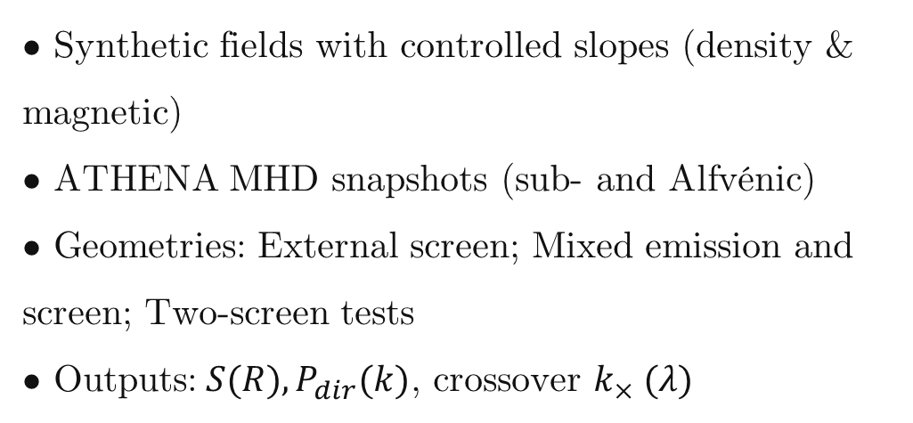
Simulation design
• Synthetic fields with controlled slopes (density & magnetic)
• ATHENA MHD snapshots (sub‑ and Alfvénic)
• Geometries: External screen; Mixed emission and screen; Two‑screen tests
• Outputs:$S(R), P_{dir}(k)$, crossover $k_{×} (λ)$
$$M_{A}=0.8,M_{S}=1.0$$
Notes:
“We validated this in two ways. First, on synthetic fields with controlled power laws, where we know the answer. Across wavelengths, the directional spectrum follows the synchrotron slope at short λ and the RM slope at long λ, with the predicted cross-over behavior. In a density-slope test, once Faraday dominates, the spectrum locks onto n-e times B-parallel, exactly as expected.

Slide 19
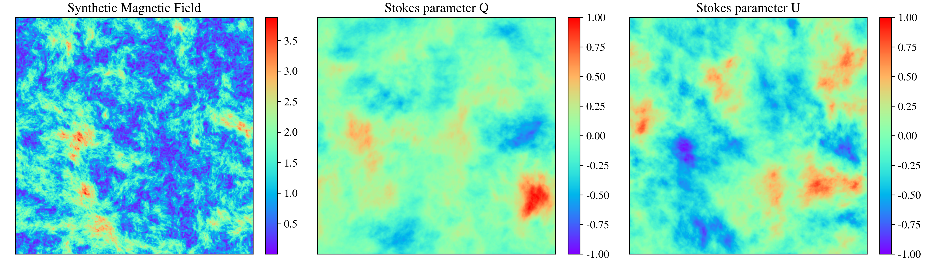
Stokes Parameters of the Synthetic Magnetic Field
Notes:
Larger titles;
TITLES- - what is written

Slide 20
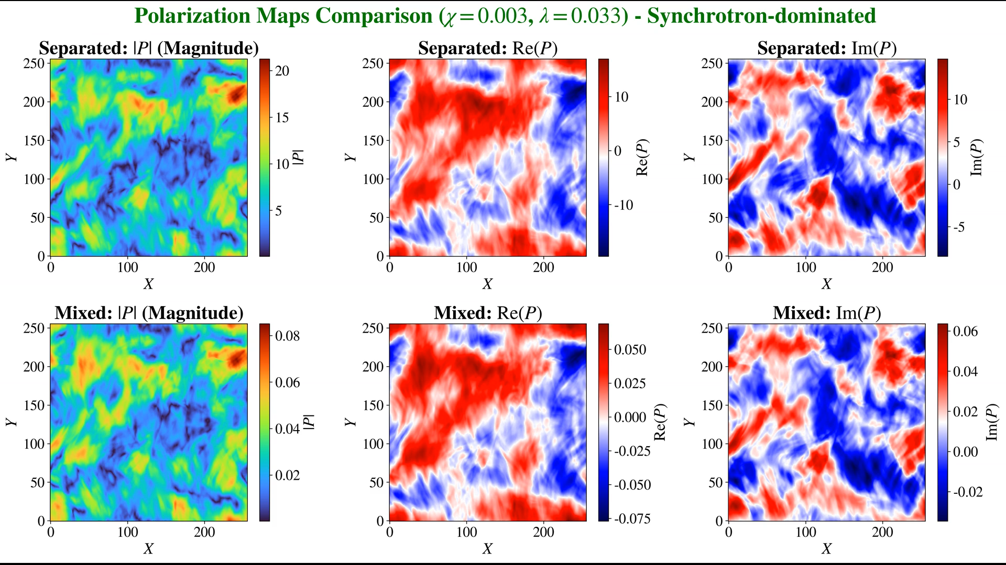
Notes:
Put what regime we are right now? Synchrotron-dominated? Transitional? Faraday-dominated?

Slide 21
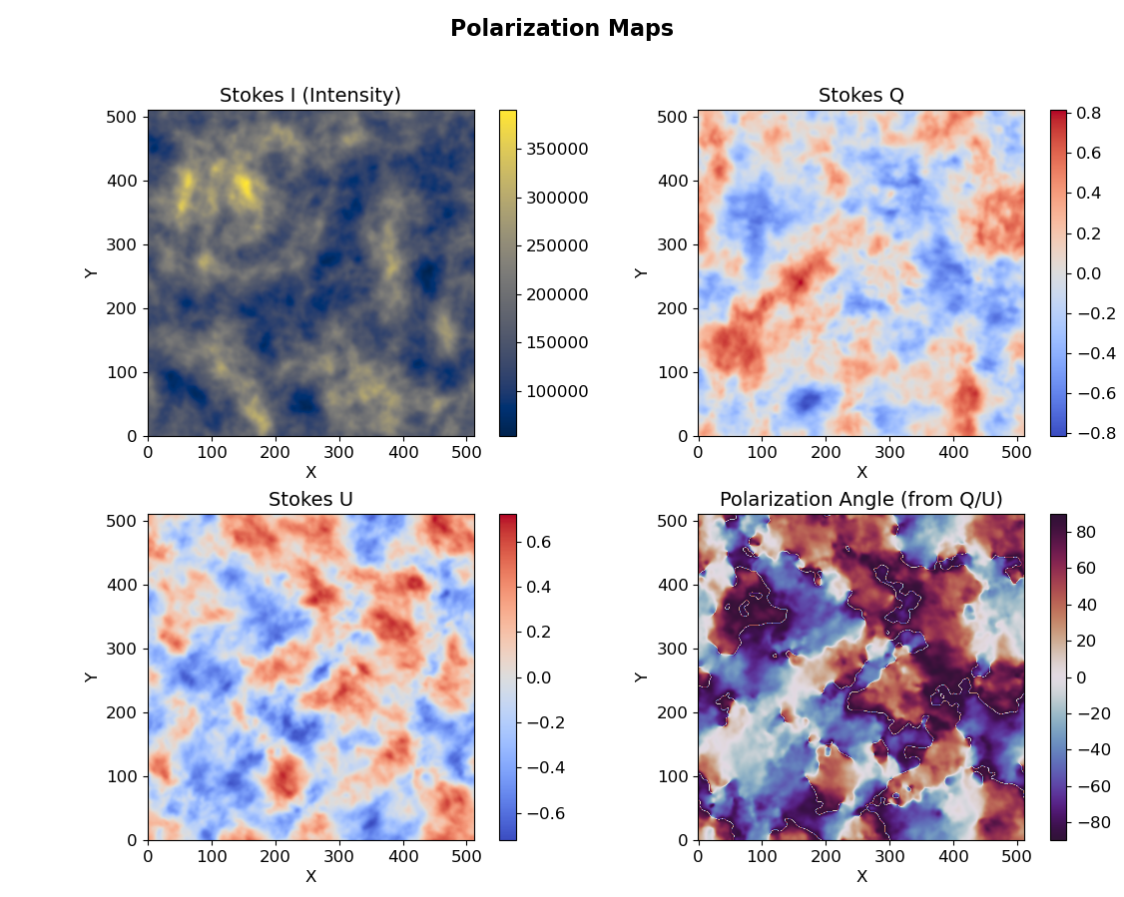
Notes:
Second, on 3-D Athena MHD cubes spanning sub- and super-Alfvénic regimes. Projected maps recover the anticipated inertial-range scaling; the measured two-dimensional slopes match the three-to-two-D mapping.

Slide 22
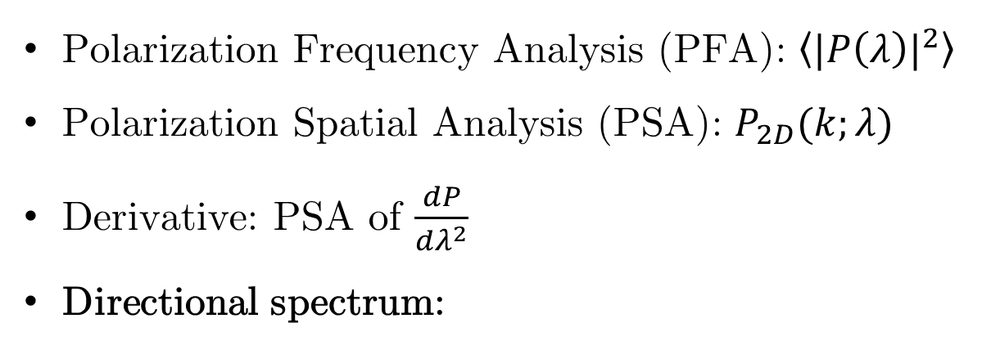
Four complementary measures
Polarization Frequency Analysis (PFA): $\left\langle {|P\left(λ\right)|}^{2}\right\rangle$
Polarization Spatial Analysis (PSA): $P_{2D}(k;λ)$
Derivative: PSA of $\frac{dP}{dλ^{2}}$
Directional spectrum:
LP16
$$P_{dir}\left(k\right)={|FFT(cos(2χ)|}^{2}+{|FFT(sin(2χ)|}^{2}$$

Slide 23
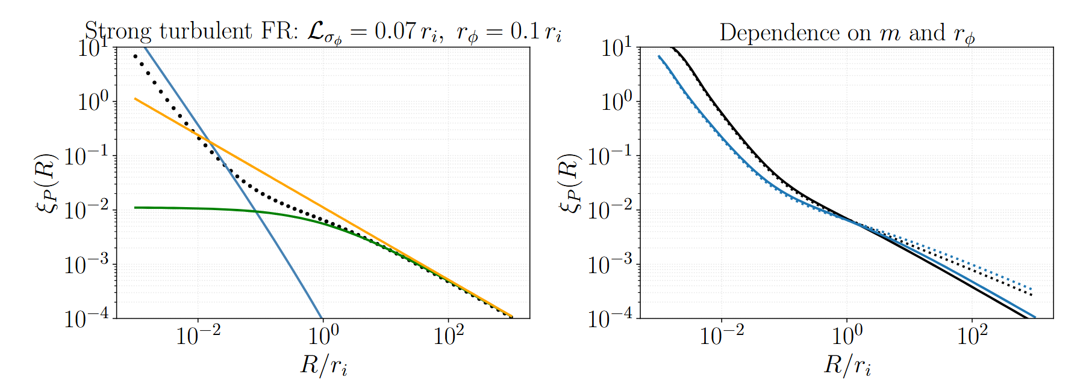

Slide 24


Slide 25


Slide 26


Slide 27




$$m_{φ}=−2/3$$
$$−2/L$$
$$−2/L$$

Slide 28






$$λ=0, χ=0$$
$$−3−m_{φ}=−11/3$$
$$−2/L$$
$$−2/L$$

Slide 29



$$−3+m_{φ}=−7/3$$
$$−2/L$$
$$−2/L$$

Slide 30


Slide 31


Slide 32


Slide 33








Slide 34

Take‑home and outlook
Single‑frequency polarization already encodes turbulence: $S(R)$ and $P_{dir}(k)$ recover slopes.
Crossover $k_{×} (λ)$ operationalizes separation of emission from screen.
Future work with LOFAR, MeerKAT, VLA archives; sets the stage for SKA when spectral coverage is sparse.

Slide 35
The Polarization Directional Spectrum - A New Turbulence Measure from Multi-frequency Synchrotron Polarization
Aliaksandr Melnichenka
Berea College
American Astronomical Society (AAS 248)
January 7, 2026
Phoenix, AZ.
Alex Lazarian (UW Madison)
Dmitry Pogosyan (University of Alberta)
Notes:
Names, conference name
“Imagine recovering the spectrum of interstellar magnetic turbulence from just one polarization map at one radio frequency. No RM synthesis. No wide bandwidth. That’s the core result of our work.”

